Slide 1


CS6030 NATURAL LANGUAGE PROCESSING
SUBJECTIVE ANSWER EVALUATION
TEAM
SANGAMITHRA V ( 2018103056 )
DIKSHIKA E ( 2018103529 )

Slide 2
INTRODUCTION
Descriptive answer exams
Useful for evaluating the student’s understanding level
Time and resource constraints prevent these writing assessments
To overcome these problems, making use of computer software (NLP) helps to analyze student writing and to understand their conceptual knowledge
Problem Statement :
Students writing descriptively provide their better understanding than multiple choice questions. Students find it difficult to attempt the descriptive answers. In order to overcome difficulties, students must use their own language to explain. The use of computer software (NLP) helps to analyse student writing and to understand their conceptual knowledge. These analyses help to see the conceptual understanding of the students and their difficulties explaining these topics and their ideas. Might be useful for automatically categorizing students’ descriptive answers. This provides teachers better insight into student thinking and class perspective that are difficult to obtain from multiple choice question.

Slide 3
OBJECTIVES - DATASET
Objectives :
To identify the correct answers for all corresponding questions in question set
• Identify the patterns of answer
• Implement the NLP (Natural language processing) approach for identifying the words probability
• Finally use the keyword extraction method and calculate marks
Dataset :
Teacher updates answers for each question in the database. This is used as reference for comparing the student’s answer.

Slide 4
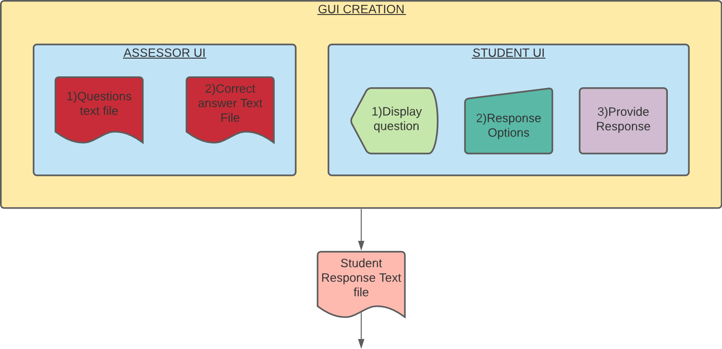
METHODOLOGY DIAGRAM
Module 1 - Spell check
Module 2 - Grammar check
Module 3 - Keyword extraction
Module 4 - Keyword matching and mark allocation
Module 5 – Total marks and Remarks

Slide 5
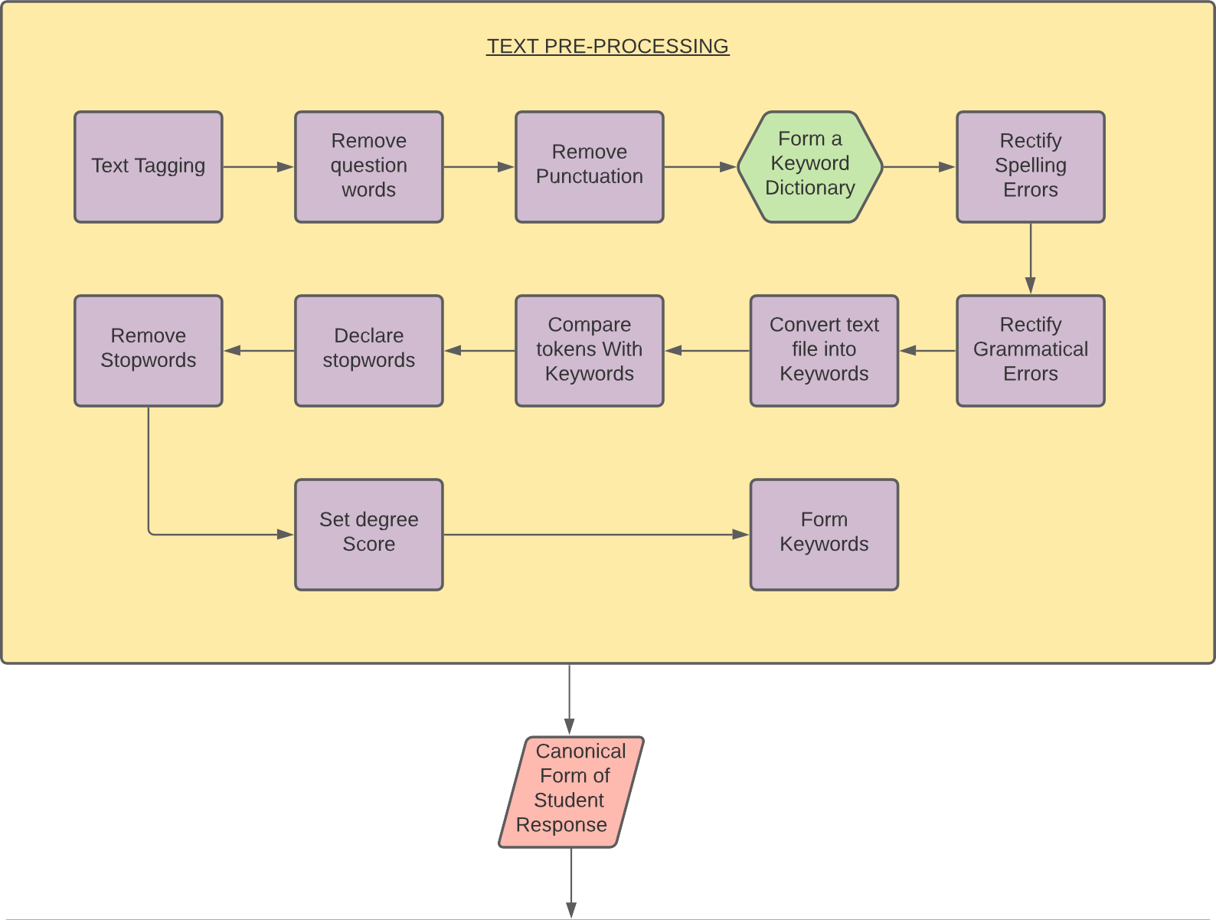
METHODOLOGY DIAGRAM – contd.

Slide 6
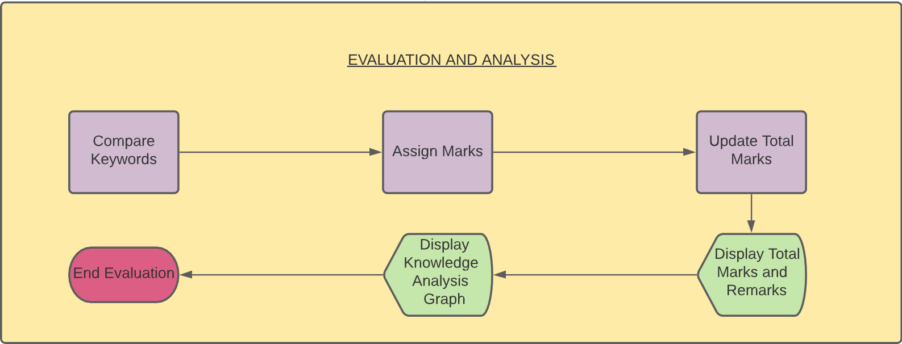
METHODOLOGY DIAGRAM – contd.

Slide 7
PERFORMANCE
Accuracy
Accuracy = Number of maximum matched keywords / Total keywords
Precision
Precision = Total number of minimum matched keywords / Total keywords
Recall
Recall = Total number of matched keywords / Total keywords
True Positive (TP) is the number of answers correctly labeled as positives
True Negative (TN) is the number of answers correctly labeled as negatives
False Positive (FP) is the number of answers incorrectly labeled as positives
False Negative (FN) is the number of answers incorrectly labeled as negatives
Measure | Mathematical Expression
Recall | TP / (TP + FN)
Precision | TP / (TP + FP)
Accuracy | (TP + TN) / (TP+TN+FP+FN)
F measure | (2×Recall × Precision) /(Recall + Precision)

Slide 8
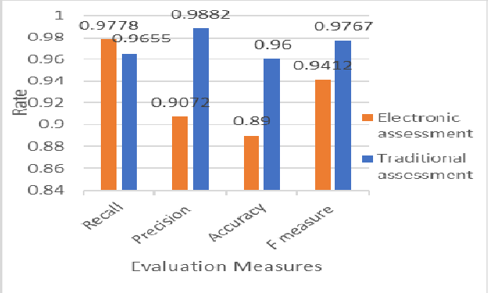
PERFORMANCE – contd.
Cosine Similarity
Jaccardian Similarity
Term Frequency – Inverse Document Frequency
Entropy
Perplexity
 | QUESTION 1 | QUESTION 2 | QUESTION 3 | QUESTION 4 | QUESTION 5
COSINE SIMILARITY | 0.55000 | 0.23094 | 0.40269 | 0.12403 | 0.35479
JACCARDIAN SIMILARITY | 0.25641 | 0.16129 | 0.14000 | 0.04000 | 0.04081
PERPLEXITY | 3.00885 | 3.56788 | 2.58420 | 3.81960 | 4.93774
ENTROPY | 4.09214 | 4.04439 | 3.98394 | 4.16545 | 4.06786

